Slide 1
Food Services: Time Reporting Requirements
Provided by the LAUSD Food Services Division
1.10.2020
Notes:
READ SLIDE:

Slide 2
Overview
Food Service Division staff are funded by multiple funding programs (NSLP, CACFP, and SFSP).
To meet Federal and State regulations regarding time and effort documentation, employees are required to fill out a time record to account for time spent in each program.
Notes:
Tell: Currently Food Service Division staff are funded by multiple funding programs (NSLP, CACFP, and SFSP). To meet Federal and State regulations regarding time and effort documentation, employees are have been required to fill out a Personal Activity Report (PAR) to account for time spent in each program.

Slide 3
Accounting Procedure
The accounting of funds between café programs will be done in the back end of SAP by our Budget and Accounting group.
The charges to the programs will be based on actual dollars used from the prior school year and will be applied this year.
Forms indicate that employees are charging only one Single Cost Objective, the SNP (National School Lunch and Breakfast Program).
Notes:
Tell: The accounting of funds between café programs will now be done in the back end of SAP by our Budget and Accounting group. The charges to the programs, will be based on actual dollars used from the prior school year. The charges will then be applied this year. Forms will now show that employees are charging only one Single Cost Objective, which will be, the SNP (National School Lunch and Breakfast Program).

Slide 4
School Based Food Service Staff
The Food Services Timesheet is the Food Services Division’s official documentation for attendance.
Attendance records:
Food Services Timesheet will be kept and filed within the Cafeteria
Employees are expected to:
Report to the cafeteria at start of shift
End shift from the cafeteria
Notes:
Tell: The new Food Services Timesheet will be Food Services' official documentation for attendance.
To avoid attendance concerns, the Food Services Timesheet will be kept and filed within the Cafeteria.
Employees are expected to report to the cafeteria at the start of their shift and end their shift from the cafeteria.

Slide 5
School Based Food Service Staff
FS staff District Timecard:
Kept within Main office
Filled out periodically
Managers work with their time reporter:
Determine schedule of filling out the timecard
Provide copies of the timesheet as needed for time reporting
At minimum timesheets provided to timekeeper:
On or before payroll cut off dates
Every Friday
Times vary dependent on school
Collaborate with the Timekeeper
Notes:
Tell: FS staff may also have a District Time Card within the Main office that will be filled out periodically. Managers should work with their time reporter to determine the schedule of filling out the time card as well as provide copies of the timesheet as needed for time reporting purposes. At minimum, the timesheets will need to be provided to the time keeper on or before payroll cut off dates as well as every Friday. Times may vary dependent on the school. Please collaborate with the Timekeeper.

Slide 6
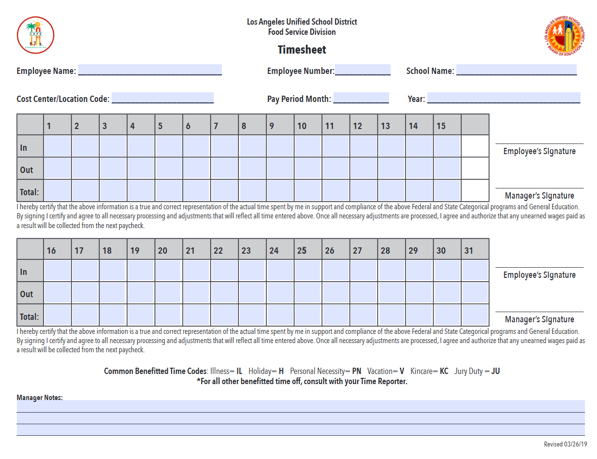
Food Service Division Time Sheet
Food Services Division Time Sheets filled out daily by:
Café Staff
Café Managers
Substitute Café Workers
Notes:
Tell: This a copy of the new Food Service Division Time Sheet. Food Services Division Time Sheets are filled out daily by: Café Workers, Café Managers, AFSS and Substitute Café Workers.

Slide 7
Employee and School Information
Heading section includes:
Employee Name
Employee Number
School
Location Code
Pay Period Month
Year
Notes:
Tell: The Food Service Division Time Sheets have been simplified for our staff.
We will briefly cover the individual sections.
The heading section requires the Employee’s Name, Employee Number and the School where the employee resides. In addition, this section includes the Location Code, Pay Period Month and the Year.

Slide 8
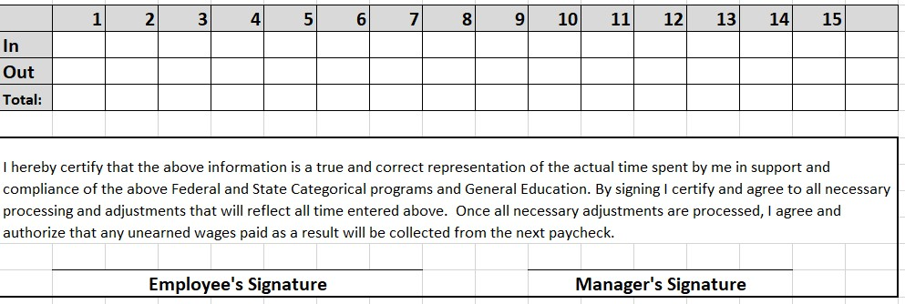
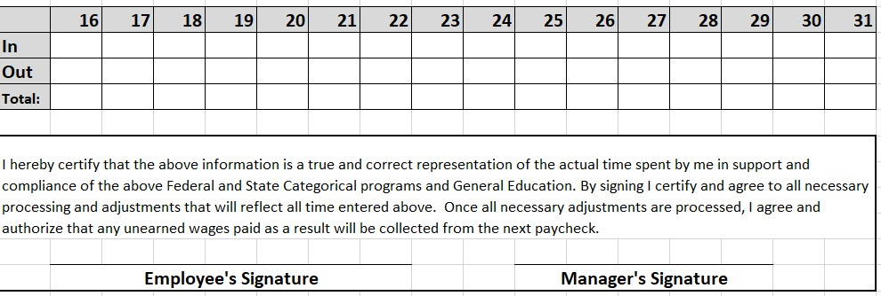
Daily Hours Worked
Fill out daily:
Arrival Time
Exit Time
All hours worked:
Assigned Hours
Additional Time
Overtime
Note: If employees qualify for a lunch break, the time will be reflected in the In/Out but will not be included in the total hours worked. *See examples
Period: 1st through 15th
Period: 16th through 31st
Notes:
Tell: Our new procedures no longer require the justification of time worked on individual tasks.
Consequently the second section, is a simple In and Out time recording procedure.
This must be filled out daily, by the employee, for ALL hours worked. These hours include their assigned hours and any additional or overtime accrued. The internal Timesheet is an addition, to the District Time Card, that remains in the Main Office with the SAA or the Office Manager.
For our purposes, the employees pay, will be based on this Food Service Timesheet.
It is still the employees responsibility to sign in and out on the District Time Card in the Main Office as well as filling in the Food Service Division Timesheet. Note: If employees qualify for a lunch break, the time will be reflected in the In/Out but will not be included in the total hours worked. *See the following examples.

Slide 9
*Example 1: 4 Hour Worker
Period: 1st through 15th
7:00
7:00
11:00
11:00
4 HR
4 HR
4 hour worker:
In:
7:00 am
Out:
11:00 am
Total = 4
Notes:
Tell: This is an example of the time record for a 4 hour worker. The worker signs In at 7:00 am and signs Out at 11:00 am. The total hours worked are 4, thus reflecting the actual hours worked without a break.

Slide 10
*Example 2: 6.5 Hour Worker
Period: 1st through 15th
7:00
7:00
2:00
2:00
6.5 HR
6.5 HR
6.5 hour worker:
In:
7:00 am
Out:
2:00 pm
Total = 6.5 Hours (excludes unpaid lunch)
Notes:
Tell: Here is an example of the time record for a 6.5 hour worker. The worker signs In at 7:00 am and signs Out at 2:00 pm. The total hours worked are 7, but here the time reflects a 30 minute lunch and 2 breaks of 10 minutes each. The worker places 6.5 hours in the Total box to designate the hours the workers actual paid hours.

Slide 11
Example 3: 6.5 Hour Worker (Out Early)
Period: 1st through 15th
7:00
7:00
2:00
9:00
6.5
2 RG/ 4.5 IL
6.5 hour worker:
In:
7:00 am
Out:
9:00
Total: 2 hours Regular, 4.5 hours Illness (reflected in Red)
Notes:
Tell: Here is an example of the time record for a 6.5 hour worker who did not finish his/her shift.

Slide 12
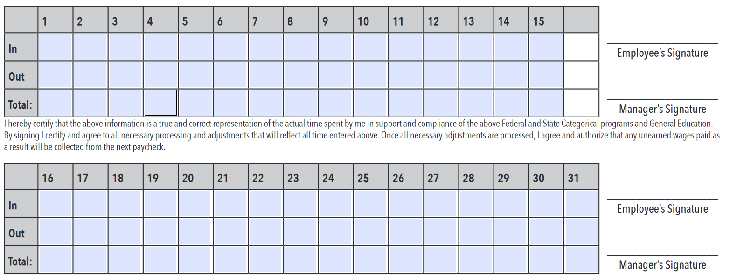
Required Signatures
Employee will sign after every pay period and Managers will sign staff timesheets after reviewing the form.
Employee signatures are a certification that all the time recorded and claimed is accurate
Only the Manager’s signature is required on his/her timesheet
Electronic signatures are not accepted
Notes:
Tell: Employee will sign after every pay period and Managers will sign staff timesheets after reviewing the form. Only the Manager’s signature is required on his/her timesheet. Employee signatures are a certification that all the time recorded and claimed is accurate. Note: Since this is not an Adobe form, electronic signatures will not be accepted.

Slide 13
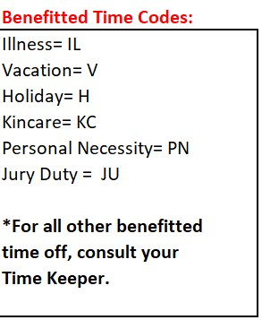
Benefitted Time Codes
Benefitted Time Codes:
Documented in the “In-Out” portion of the Time Sheet
Must be in Red ink
Absence forms are required to be completed upon the employee’s return.
Notes:
Tell: If the employee will not be working on an individual day, the Benefitted Time Code(s) must be used in the “In and Out” portion of the Time Sheet. These Codes MUST be listed in Red ink.
The remainder of the Time Sheet may be filled out in, preferably Black ink, although Blue is acceptable. Pencil should never be use to fill in these Time Sheets.

Slide 14
Manager Note Section
Manager’s Notes are used for:
Explanations for additional hours and overtime
Absences
Clarification
Adjustments made to reported time
Errors on Timesheet
Notes:
Tell: This Food Service Division Timesheet also includes a section for the Manager to add their Notes for explanation and clarification.

Slide 15
Supporting Forms
Forms that support attendance variations:
Additional Time/Overtime form
Mileage/Flat Rate form
Certification/Request of Absence Forms
Illness
Non-Ilness
Notes:
Tell: The Additional Time Form/Overtime form and Mileage/Flat Rate form have been simplified by removing program specific columns. The approval process remains the same for these documents.

Slide 16
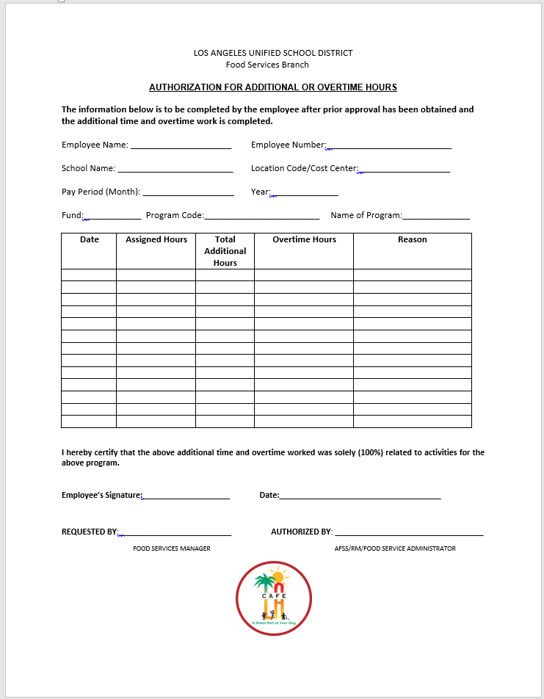
Authorization for Additional or Overtime Hours
Authorization for Additional or Overtime Hours forms are filled out by:
Café Manager
Authorized by:
AFSS
Regional Food Services Manager
Food Services Administrator
Notes:
Tell: This is the new Authorization for Additional or Overtime Hours work sheet. It is filled our by the Café Managers for their workers. The authorization for the additional hours comes from the AFSS or the Food Services Administrator.

Slide 17
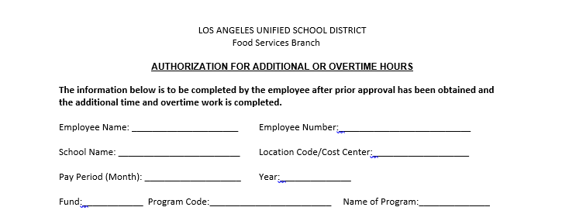
Header
Managers will complete the header of the form with all information requested.
130-5310
SNP
17025 (School Based) 17028 (Central Office)
Notes:
As with the Food Service Division Time Sheets, the top section covers the Employee’s Name, Employee Number, the School Name, Location Code and the Pay Period Month and the Year.

Slide 18
Additional Hours/Overtime Worked
Manager will complete additional time worked:
Date
Assigned Hours
Total Additional Hours
Overtime Hours
Reason
1.26.20
6.5
1.5
Hot Supper
Notes:
Tell: The second portion of the form, has also been simplified, to include the Date, Assigned Hours, Total Additional Hours, Overtime Hours and a Reason section.
The Reason section will be utilized to justify any Additional Hours, Overtime Hours, or any anomalies in the Time Request.
The overtime hours are requested by the Café Manager and authorized by the AFSS or Food Services Administrator.

Slide 19
Verification Signature
Employee signatures are a certification that all the time recorded and claimed on the form is accurate.
Manager submits form to AFSS for approval for all staff and signs the REQUESTED BY section.
Electronic signatures are accepted by the AFSS in the AUTHORIZED BY section.
Notes:
The overtime hours are requested by the Café Manager and authorized by the AFSS or Food Services Administrator.

Slide 20
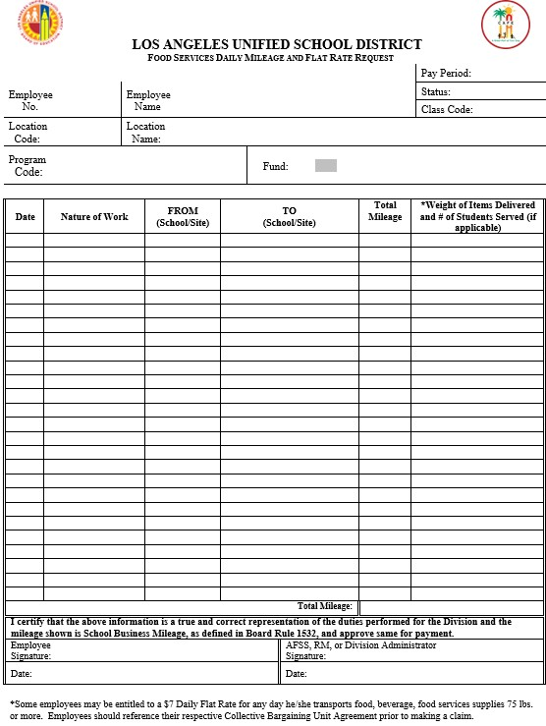
Food Services Daily Mileage and
Flat Rate Request
Food Services Daily Mileage and Flat Rate Request:
Filled out by Café Manager for:
Café Workers
Notes:
Tell: The Food Service Daily Mileage and Flat Rate Request form has been simplified as well. This form is filled out by the Café Managers for their workers and authorized by the AFSS or Division Administrator.

Slide 21
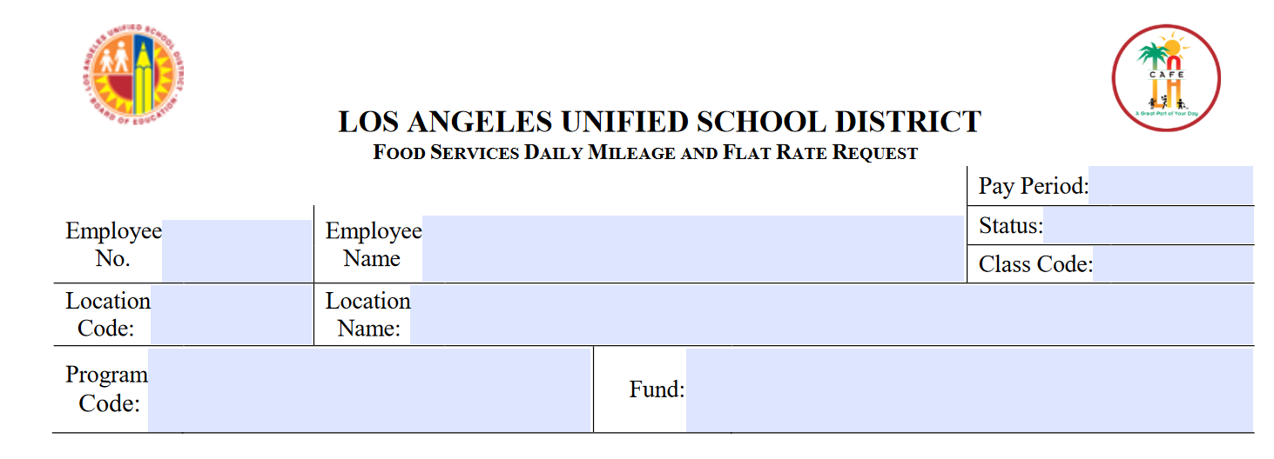
Header
Notes:
Tell: The top portion of the form includes the following: Employee Number, Name, Pay Period, Status, Class Code, Location Code, Location Name, Program Code and Fund Line.
The Mileage portion has also been simplified. It includes the: Date, Nature of the Work, From (School Site), To (School Site), Total Mileage and the “Weight of the Items Delivered and Students Served
(if applicable). If a Flat Rate Request is being made, this “Weight/Delivered” portion is used to justify that.

Slide 22
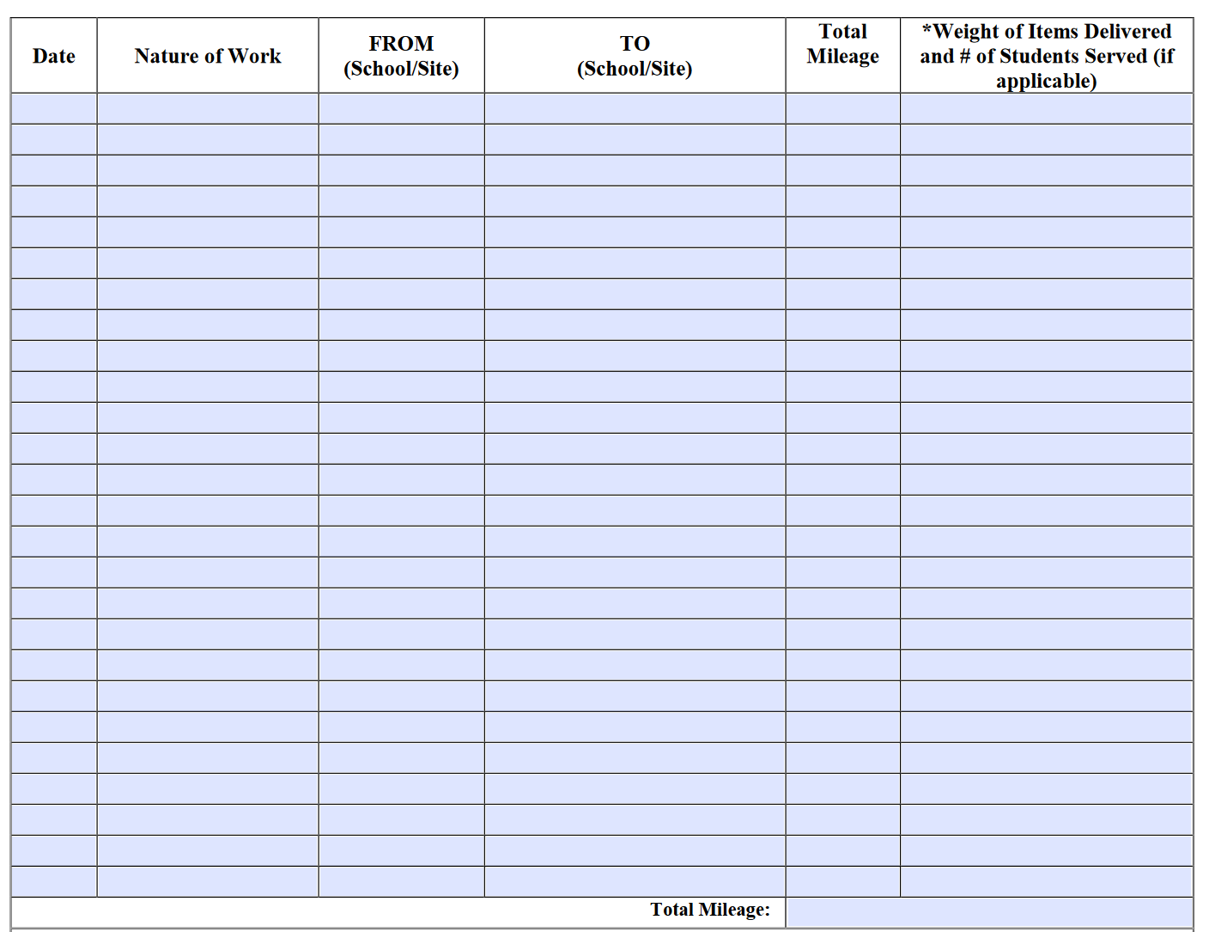
Mileage Claimed
Employee will complete mileage information:
Date
Nature of Work
From Site
To Site
Total Mileage
Weight of Item (If Applicable)
Notes:
Tell: The top portion of the form includes the following: Employee Number, Name, Pay Period, Status, Class Code, Location Code, Location Name, Program Code and Fund Line.
The Mileage portion has also been simplified. It includes the: Date, Nature of the Work, From (School Site), To (School Site), Total Mileage and the “Weight of the Items Delivered and Students Served
(if applicable). If a Flat Rate Request is being made, this “Weight/Delivered” portion is used to justify that.

Slide 23
Verification Signatures
Employee signatures are a certification that all the time recorded and claimed on the form is accurate.
Manager submits form to AFSS for approval for all staff
Electronic signatures are accepted by the AFSS
Notes:
Tell: The bottom portion of the document includes the certifying statement(s), where the employee verifies that the above information is true and correct. The request is made by the employee and authorized by the AFSS, Regional Manager or the Division Administrator.

Slide 24
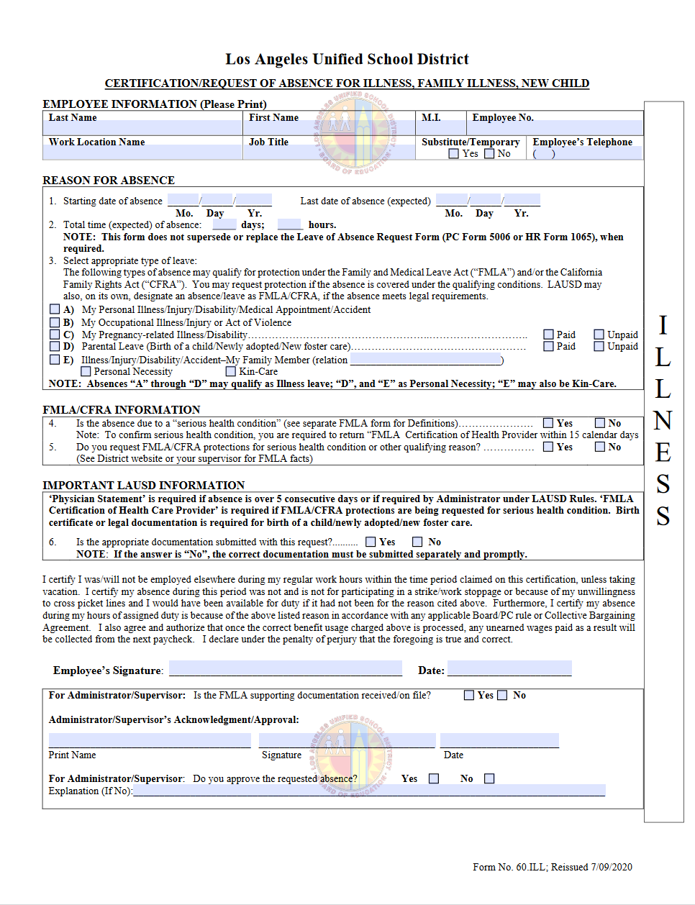
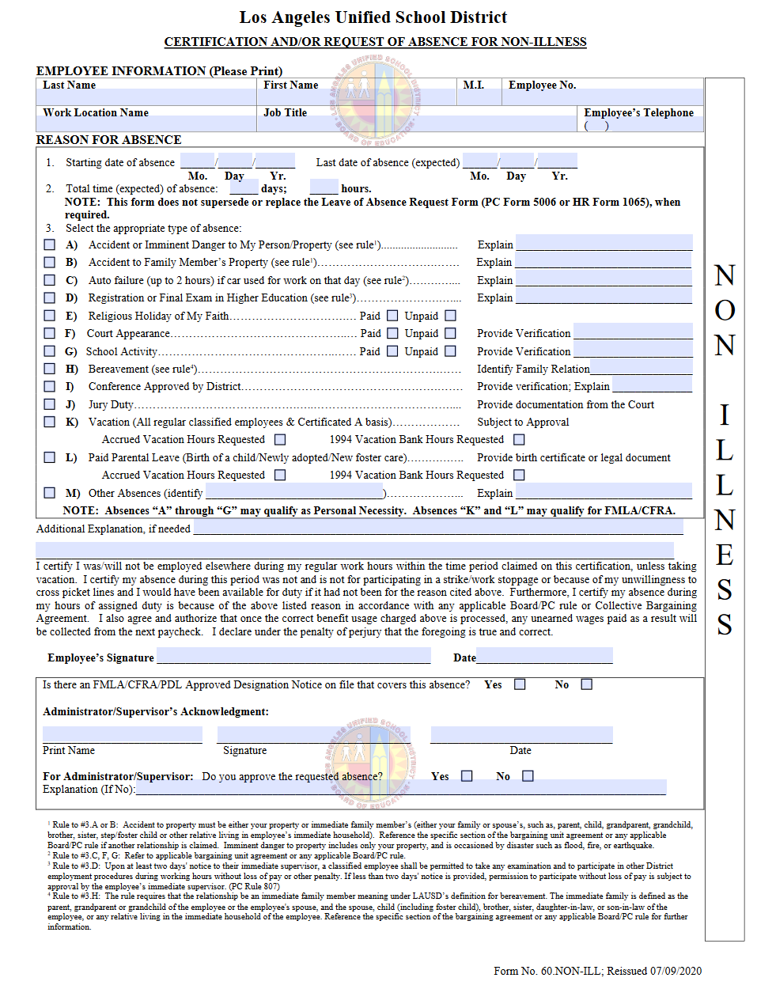
Certification/Request of Absence Forms
ILLNESS
NON-ILLNESS
Notes:
Tell: The Food Service Daily Mileage and Flat Rate Request form has been simplified as well. This form is filled out by the Café Managers for their workers and authorized by the AFSS or Division Administrator.

Slide 25
Non-Illness
Accident or Imminent Danger
Accident to Family Member’s Property
Auto Failure
Registration or Exam of Higher Education
Religious Holiday
Court Appearance
School Activity
Bereavement
Jury Duty
Vacation
Paid Parental Leave
Other Absences
(must clarify)
Absence Forms
Illness
Personal Illness
Occupational Illness
Pregnancy Related Illness/Disability
Parental Leave
Illness/Injury/Disability/ Accident-Family Member
PN or KinCare
Notes:
Tell: Now that time is being charged 100% in a Single Cost Objective, the CDE requires all employees to fill out the Periodic Certification or alternatively, the Blanket Periodic Certification. Previously, these forms were called “Semi-Annual Certifications.” Certifications are required twice a year: July1st through December 31st and January 1st through June 30th

Slide 26
Periodic Certifications
CDE requires all employees to fill out the Periodic Certification or alternatively, the Blanket Periodic Certification.
Certifications are required twice a year:
July 1st through December 31st
January 1st through June 30th
Notes:
Tell: Now that time is being charged 100% in a Single Cost Objective, the CDE requires all employees to fill out the Periodic Certification or alternatively, the Blanket Periodic Certification. Previously, these forms were called “Semi-Annual Certifications.” Certifications are required twice a year: July1st through December 31st and January 1st through June 30th

Slide 27
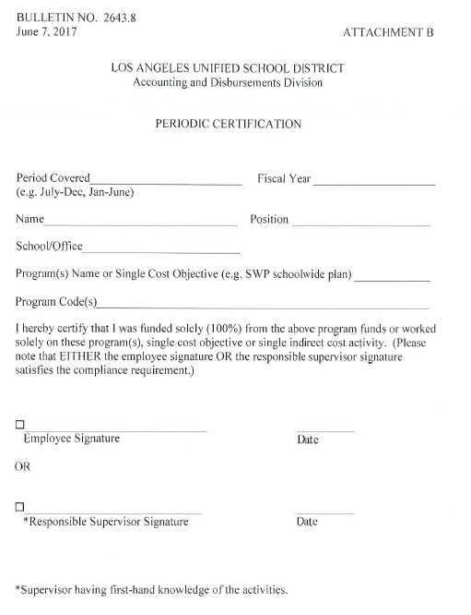
Periodic Certification Attachment “B”
Periodic Certification Forms are filled out by:
NNC Staff
Central Office Staff
Substitute Food Service Workers
Managers will have Subs Certify themselves at their site
Managers for workers that are retired, leave of absence, workers comp.
Other District employees 100% funded by Café funds
Notes:
Tell: There are two different Certification forms.
The Periodic Certification Form, Attachment “B” is used for the individual. Periodic Certification Forms are filled out by: NNC Staff, Central Office Staff and Substitute Food Service Workers. The Managers will have Subs Certify themselves at the Managers site, if they have not already done so elsewhere. In addition, the Managers will also certify for workers that are retired, on leave of absence, for workers comp, and other District employees that are 100% funded, by Café funds.

Slide 28
Retired or Resigned Worker
If a worker retired or resigned in the middle of the certification period, an individual Periodic certification must be filled out by the Supervisor.
Ex: Employee began work in August but retired on October 31st. The period worked is Aug - Oct. The Manager will then check off the box and sign as the “Responsible Supervisor Signature.”

Slide 29
Substitutes
Substitutes will have a slightly different process since their job assignments will vary.
Subs fill out an individual periodic certification at each location they are assigned.
Ex 1: Sub assigned April 1- April 8 at ABC Elementary. One periodic certification is filled out for the time frame of April 1-April 8th. The certification is maintained at ABC Elementary.
Ex 2: Same sub is then assigned April 15th-April 30th at 123 High. One periodic certification is filled out for the time frame of April 15th-April 30th. The certification is maintained at 123 High.

Slide 30
Attachment “B
Period Covered:
July –December
January – June
Program Name: SNP
Program Code:
School Based: 17025
Central Office: 17028
Notes:
Tell: Additional information on the form includes the Certification Period Covered, the Program Name and the Program Code. School Based Certifications are coded 17025 and Central Office Based are coded 17028.

Slide 31
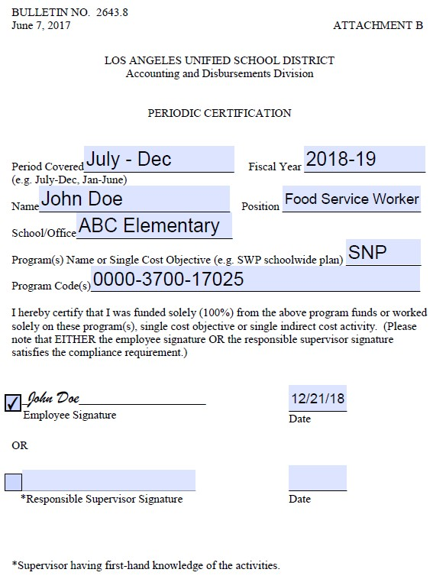
Completed Periodic Certification Form
Fill out all areas on the
“Periodic Certification” form Attachment “B”.
Note: The date at the bottom for the individual periodic certification should reflect the last day worked in the period.
Notes:
Tell: Here is an example of how to fill out the Individual Periodic Certification form Attachment “B”.

Slide 32
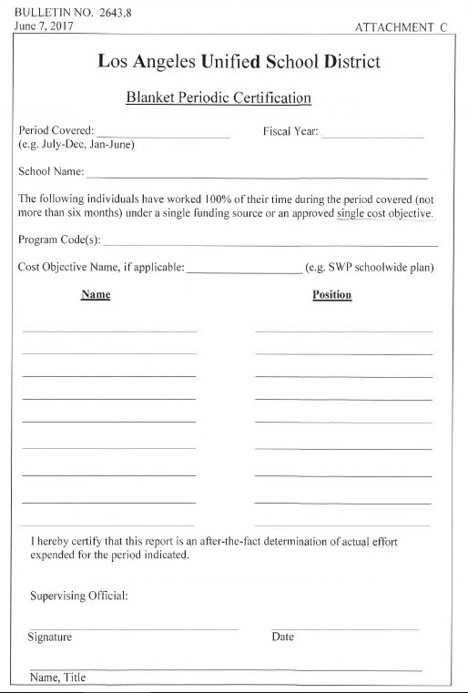
Blanket Periodic Certification Attachment “C”
Blanket Certification Forms are filled out by:
Managers for all Café Staff on site
AFSS for their assigned Food Services Managers
Central/NNC will fill out an individual Periodic Certification
Note: Blanket certifications should only cover employees who worked the same period covered.
Notes:
Tell: This is the Blanket Periodic Certification form, Attachment “C”. This form is used to certify a group of individuals. Blanket Certification Forms are filled out by: Managers for their Café Workers and the AFSS for their Managers groups.

Slide 33
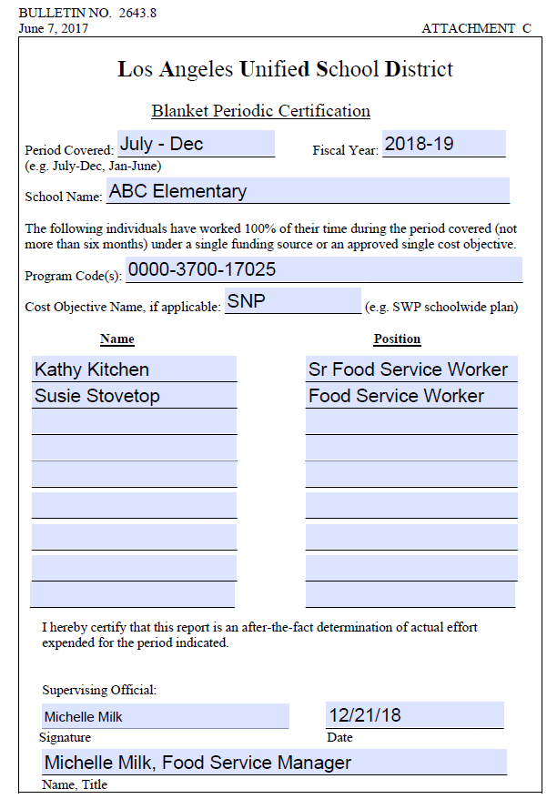
Completed Blanket Periodic Certification Form
Fill out “Blanket Periodic Certification” form Attachment “C” for all staff.
Note: The date at the bottom for the individual periodic certification should reflect the last day worked in the period.
Notes:
Tell: This is an another example of how to fill out the Blanket Periodic Certification form
Attachment “C”.

Slide 34
Completion Dates and Filing
The Jan- June certification period is due immediately.
Process taking place in mid-year
Please submit the certifications by Monday, June 3rd.
Managers and Area Food Services Supervisors:
Managers send it to your AFSS who will send it to the Food Services Staff Aides
Employees who retired, resigned, or are currently on leave during this timeframe must also be included
Notes:
Tell: The first certification (July 1st-Dec. 31st) due immediately. This is happening because the process is taking place in mid-year. The Blanket Periodic Certification for sites is due by April 15th. The Managers and Area Food Services Supervisors must send their certifications to their Food Services Staff Aide. Employees who retired, resigned, or are currently on leave during this timeframe must also be included in the certifications. Please note that Subs must also fill out the individual Periodic Certification form. Mangers will need to have their subs fill out the form and submit it on their behalf by April 15th if the Sub has not been previously certified at another site.

Slide 35
Questions?
Thank You!
Notes:
READ SLIDE:

